Slide 1
Chapter 2-1
SECTION 1.2 REVIEW
Fundamentals of Marketing
- click twice to continue -

Slide 2
Market Share Quiz on Google Classroom.

Slide 3
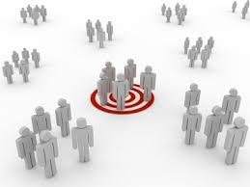
Target Market and Market Segmentation
Marketers look for ways to find those who want their product most:
market segmenting: is the process of classifying customers by needs and wants
Goal = find people most likely to become customers
target market: A group of people identified as those most likely to become customers
all marketing strategies directed at target market

Slide 4

Customer Profile
To develop a clear picture of its target market, a business creates a customer profile
customer profile X A list of information about the member of a target market most likely to buy my product
What are some things that can be used to segment a target market?
Student contributions?

Slide 5
Customer Profile
There are many ways to segment a market.
Common ways to segment a target market:
Age
Gender
Income level
Ethnic background
Marital Status
Lifestyle/Interests/Hobbies
Geographic residence
How, what, where and when do they buy

Slide 6

Snowmobile Example:
Age :
Gender:
Income level:
Geographic residence:
Marital Status
Ethnic background:
Occupation
Lifestyle/Interests/Hobbies:
Person(s) most likely to buy my product

Slide 7
Snowmobile Example:
Age : 40 and older
Gender: Males
Income level: Middle to Upper class
Geographic residence: Colder Climate areas that get snow
Marital Status – Married with children
Ethnic background: N/A
Occupation – N/A
Lifestyle/Interests/Hobbies: active outdoor lifestyle in the winter, family fun outdoor activity
Person(s) most likely to buy my product

Slide 8

What company is this LOGO
Most of not all of you recognize this. What is this called?
Brand Penetration

Slide 9
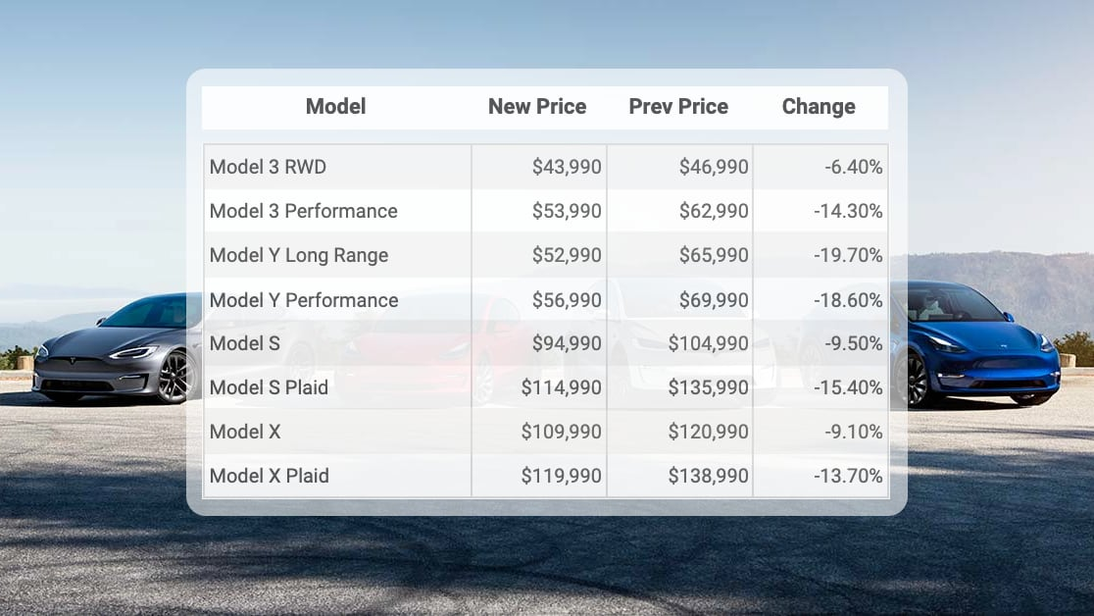
Tesla Assignment Model
Your teacher will sign your work
Person(s) most likely to buy my product

Slide 10

Answers to the Tesla Assignment

